Slide 1
JS
SYNCHRONOUS
ASYNCHRONOUS

Slide 2

OBJECTIVES
What is the difference between synchronous and asynchronous calls ?
What is a callback ?
setTimeOut to call a function after some time

Slide 3


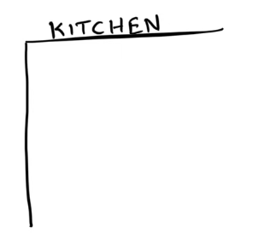



GAME
…
The Restaurant
45 MIN
TEAM of 8

Slide 4
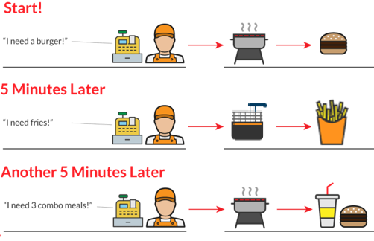
Synchronous calls
You wait until function returns

Slide 5
Synchronous calls
let order1 = takeOrder(table1);
let dish1 = cook.makeMeal(order1);
serveTable(dish1)
let order2 = takeOrder(table2);
let dish2 = cook.makeMeal(order2);
serveTable(dish2)

Slide 6
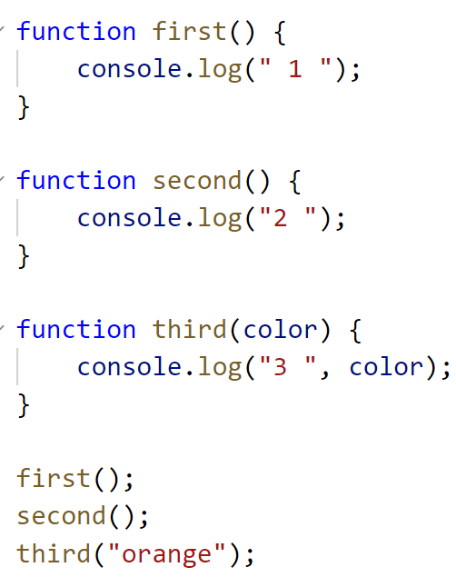
PRACTICE
ACTIVITY 1
10MIN
INDIV
1
Run code
2
Explain what you see on console
3

Slide 7
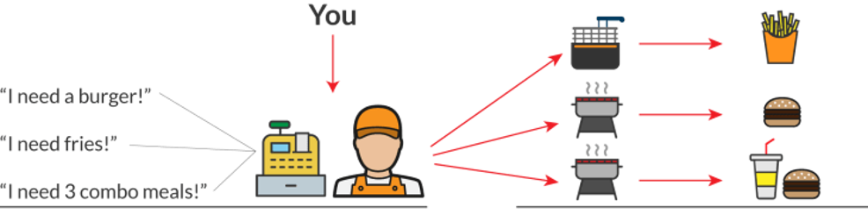
Asynchronous calls
Don’t wait for function to return

Slide 8
Asynchronous calls
let order1 = takeOrder(table1);
cook.makeMeal(order1, (dish) => serveTable(dish));
let order2 = takeOrder(table2);
cook.makeMeal(order2, (dish) => serveTable(dish));

Slide 9
SYNTAX
Arrow functions
Normal style
Arrow style
function findMin(number1, number2) {
if (number1<number2) {
return number1;
}
else {
return number2;
}
}
let findMin = (number1, number2) => {
if (number1<number2) {
return number1;
}
else {
return number2;
}
};

Slide 10
PRACTICE
10MIN
INDIV
ACTIVITY 2
Convert activity 1 function
To arrow functions

Slide 11
SYNTAX
SetTimeOut
function doSomething() {
// code
}
setTimeout(doSomething, 500);
Call this function…
…After 500ms

Slide 12
PRACTICE
ACTIVITY 3
10 MIN
Run code
Explain what you see on console

Slide 13
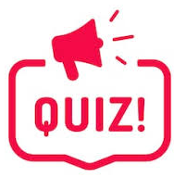
What this code will print ?
setTimeout( () => { console.log("BANANA"); }, 3000);
console.log("MANGO");
setTimeout( () => { console.log("APPLE"); }, 2000);
console.log("JACKFRUIT");
setTimeout( () => { console.log("ORANGE"); }, 1000);

Slide 14
CODE
EXECUTION
setTimeout( () =>
{ console.log("BANANA"); }, 3000);
console.log("MANGO");
setTimeout( () =>
{ console.log("APPLE"); }, 2000);
console.log("JACKFRUIT");
setTimeout( () =>
{ console.log("ORANGE"); }, 1000);
console.log("MANGO");
console.log("JACKFRUIT");
1
secs
2
secs
3
secs
console.log(“ORANGE");
console.log(“APPLE ");
console.log(“BANANA ");

Slide 15
A callback is a function that is passed as a parameter to another function;
Examples:
function onClick(event) {
console.log('User clicked on button !');
}
myButton.addEventListener('click', onClick);
function timeOver() {
console.log('Time is over !');
}
setTimeout(timeOver, 10000);
callback
callback

Slide 16
PRACTICE
ACTIVITY 4
10 MIN
Instructions are in the code

